Slide 1
Salt technological composition (STC) for the gas & oil wells completion and workover

Slide 2
Technologic liquid specific gravity for the well completion and workover brines

Slide 3
STC liquid types
Highly mineralized brines for well completion and workover
In the forms of the dried mix or water liquids of the required density
Efficient inhibit properties prevents hydration
Controlled rheological properties
Low corroding activity
Brine consists of the inhibit scaling additions
STC type | Density, gr/cm³ | Viscosity, sec | F, cm³/30 minutes | Corrosion speed, mm/year
1300 | 1,10-1,35 | 20-50 | from 5 | <0,06
1600 | 1,35-1,60 | 90-200 | from 10 | <0,125
1800 | 1,60-1,80 | 40-230 | from 8 | <0,125
1900 | 1,80-1,90 | 39-180 | from 5 | <0,125
2000 | 1,90-2,00 | 80-135 | from 8 | <0,125
2100 | 2,00-2,10 | 80-150 | from 10 | <0,125

Slide 4
Composition of the STC liquid for the AHRP gasoil wells (abnormally high formation pressure)
In accordance with the appropriate Russian ‘technical conditions’ STC is the composition of the dried salts designed for making heavy liquids without the solid phases having the density (specific gravity) in the range of 1100 ~ 2100 kg/m3
Mineralized liquids made on the basis of STC are used as process liquids for the testing, development, perforation, killing and workover purposes
STC water liquids can also be used as behind-the-packer process fluid with the controllable filtrating & rheological properties depending on the downhole pressure

Slide 5
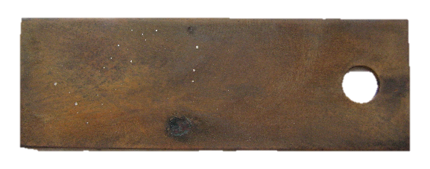
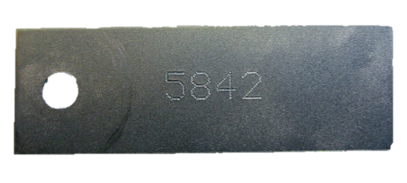
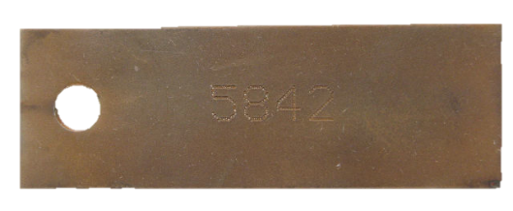
Corroding activity examples on the steel plates (steel type “D”)
Without inhibits
Using inhhibits
Before thermostating
After 72 hours from thermostating

Slide 6
Results of the testing for the corroding activity of the liquid based on STC type 1800
Liquid type | Exposition time, hours | Temperature during tests, °С | Corroding depth, mm/year
Liquid based on the STC-1800 (having density of 1800 kg/m³ ) | 72 | 110 | 0,0825
Tests have been carried in accordance with the Russian GOST system (state technical standards). Corroding speed has been registered with the help of the gravimetric method (test example weigh loss)

Slide 7
Dependency of the solution crystallization temperature from the density of the liquid based on STC-1800

Slide 8
Technological specifics of preparing and usage of the liquids based on STC-1800
While preparing of highly concentrated salt compositions (increased density) the solubility of salts is decreased dramatically. In this regard the suspension of crystals can be in place and they can sink on the bottom of the container if not mixed properly
To increase the solubility of salts intensive mixing is required using mechanical of hydraulic tools. Required temperature during this process should be within the range of 40-50 degrees Celcius
Periodic cleanup of the salt compositions from solid phases of different nature as well as adding the inhibitors are required in order to prevent negative influence of the process liquids on the oil-reservoir rocks

Slide 9
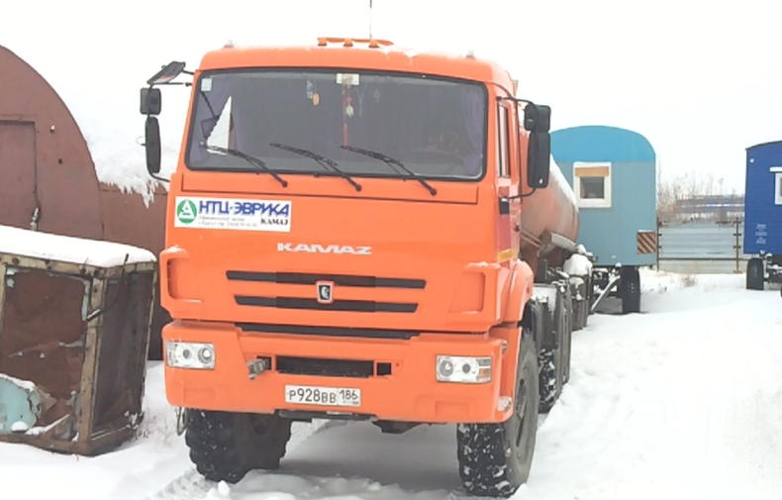
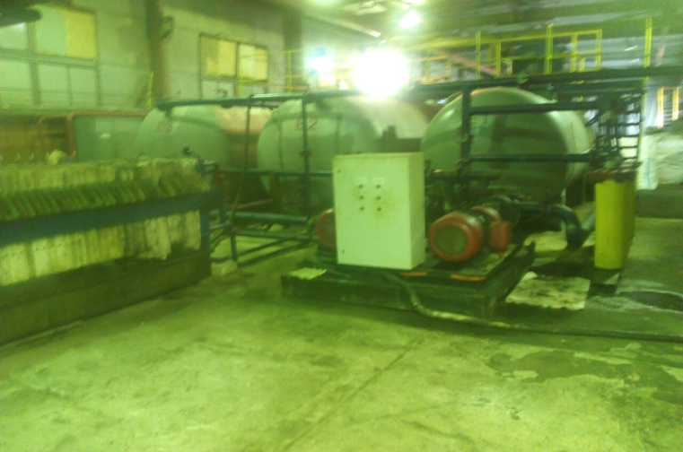
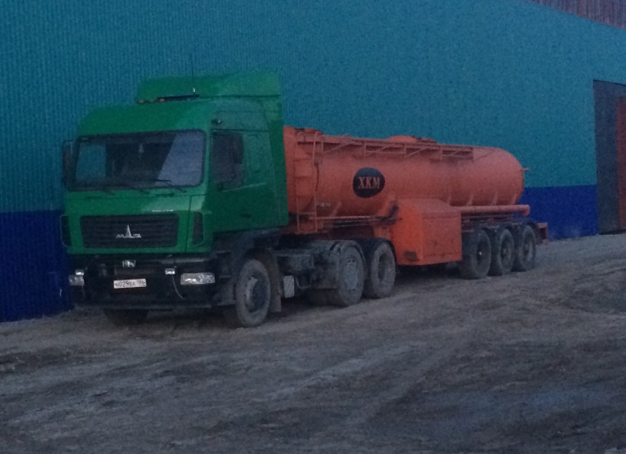
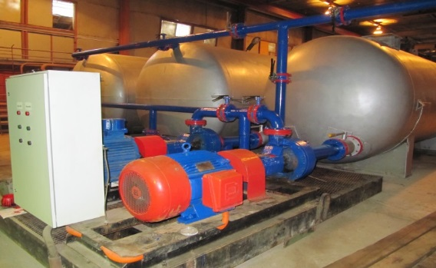
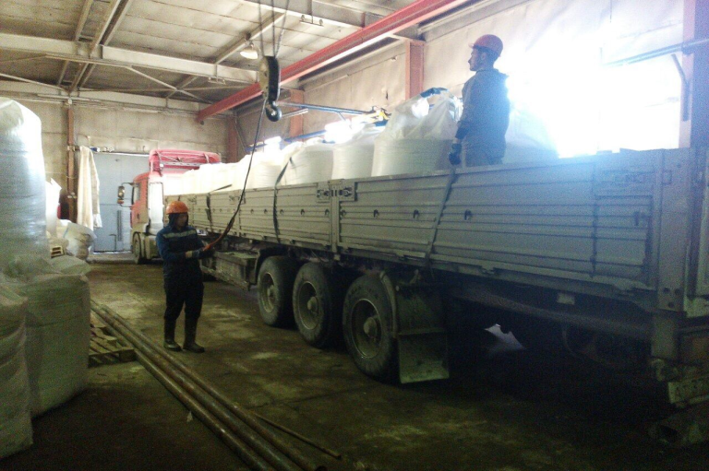
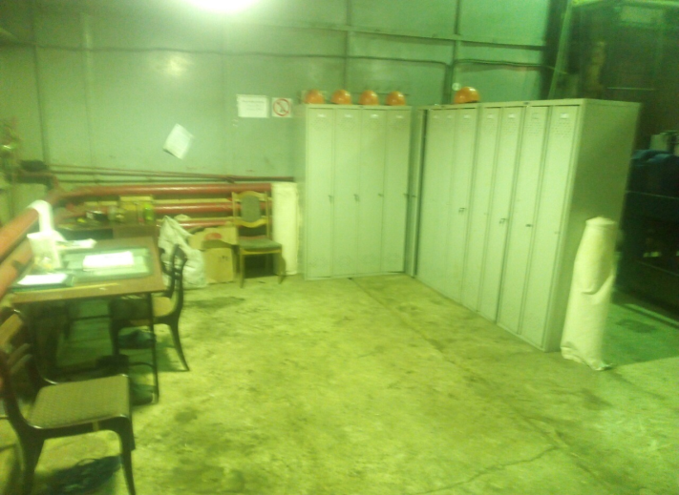
Heavy process liquids production and regeneration unit in the Russian Siberia region

Slide 10
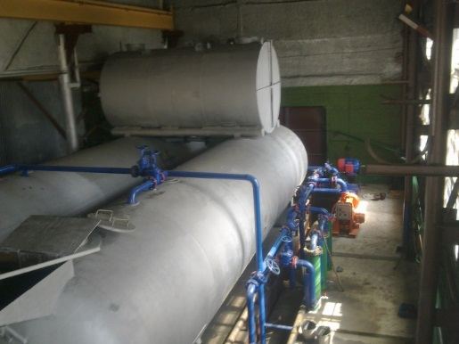
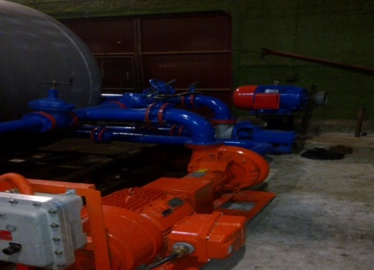
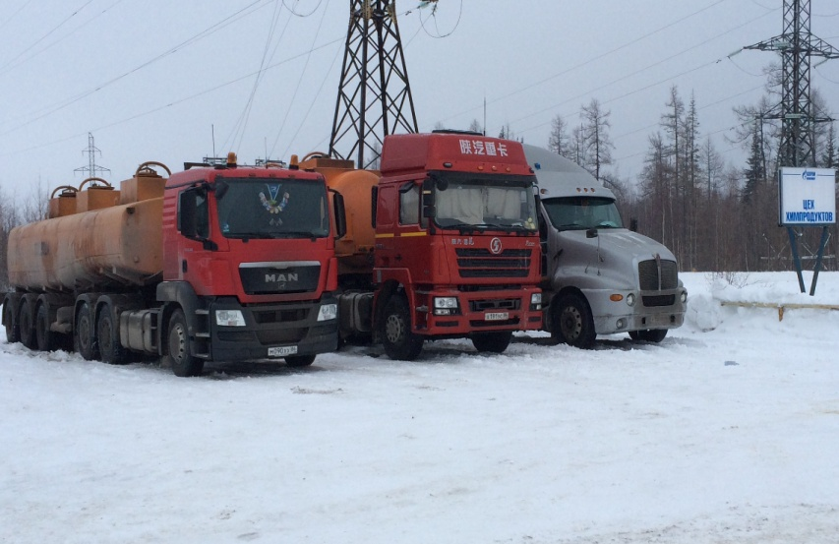
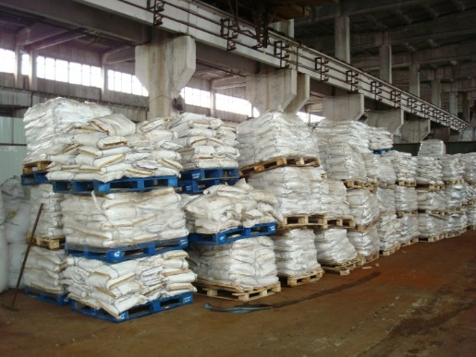
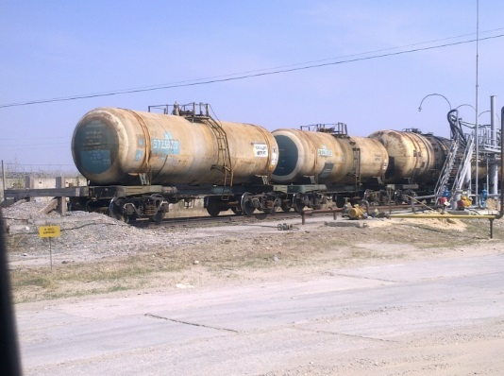
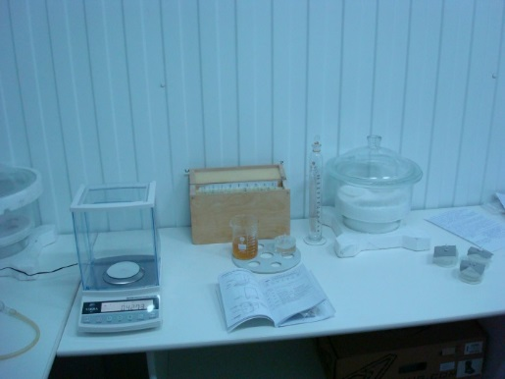
Next unit of the heavy process liquids production and regeneration (located in another Siberia region)

Slide 11
Advantages
Expertise from Y2009 – time-proven solution for the numerous of Russian gas and oil companies
Several production units
More than 8 years of successful experience of using STC-1800 in GASPROMNEFT, LUKOIL, SLAVNEFT, ARCTICA
In-house laboratory and constant control of both incoming supplies and ready-to-ship goods

